Slide 2
Haggai 1 (ESV)
¹ In the second year of Darius the king, in the sixth month, on the first day of the month, the word of the Lord came by the hand of Haggai the prophet to Zerubbabel the son of Shealtiel, governor of Judah, and to Joshua the son of Jehozadak, the high priest: ² “Thus says the Lord of hosts: These people say the time has not yet come to rebuild the house of the Lord.” ³ Then the word of the Lord came by the hand of Haggai the prophet, ⁴ “Is it a time for you yourselves to dwell in your paneled houses, while this house lies in ruins? ⁵ Now, therefore, thus says the Lord of hosts: Consider your ways. ⁶ You have sown much, and harvested little. You eat, but you never have enough; you drink, but you never have your fill. You clothe yourselves, but no one is warm. And he who earns wages does so to put them into a bag with holes.

Slide 3
Haggai 1 (ESV)
⁷ “Thus says the Lord of hosts: Consider your ways. ⁸ Go up to the hills and bring wood and build the house, that I may take pleasure in it and that I may be glorified, says the Lord. ⁹ You looked for much, and behold, it came to little. And when you brought it home, I blew it away. Why? declares the Lord of hosts. Because of my house that lies in ruins, while each of you busies himself with his own house. ¹⁰ Therefore the heavens above you have withheld the dew, and the earth has withheld its produce. ¹¹ And I have called for a drought on the land and the hills, on the grain, the new wine, the oil, on what the ground brings forth, on man and beast, and on all their labors.”

Slide 4
Haggai 1 (ESV)
² Then Zerubbabel the son of Shealtiel, and Joshua the son of Jehozadak, the high priest, with all the remnant of the people, obeyed the voice of the Lord their God, and the words of Haggai the prophet, as the Lord their God had sent him. And the people feared the Lord. ¹³ Then Haggai, the messenger of the Lord, spoke to the people with the Lord's message, “I am with you, declares the Lord.” ¹⁴ And the Lord stirred up the spirit of Zerubbabel the son of Shealtiel, governor of Judah, and the spirit of Joshua the son of Jehozadak, the high priest, and the spirit of all the remnant of the people. And they came and worked on the house of the Lord of hosts, their God, ¹⁵ on the twenty-fourth day of the month, in the sixth month, in the second year of Darius the king.

Slide 6
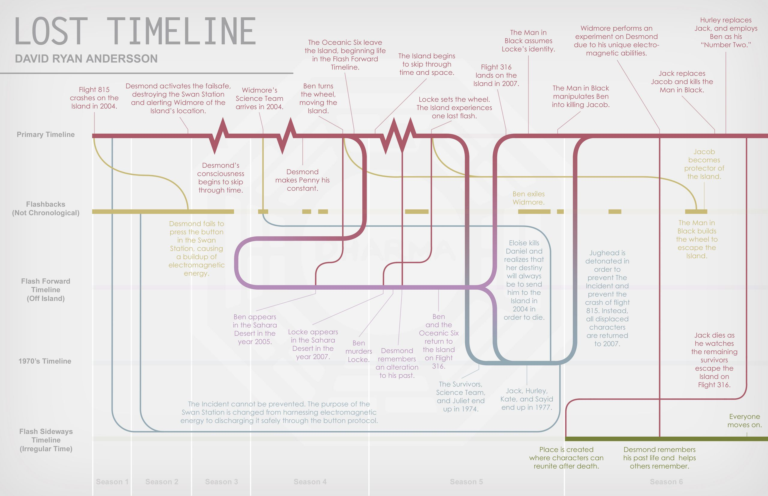

Slide 7
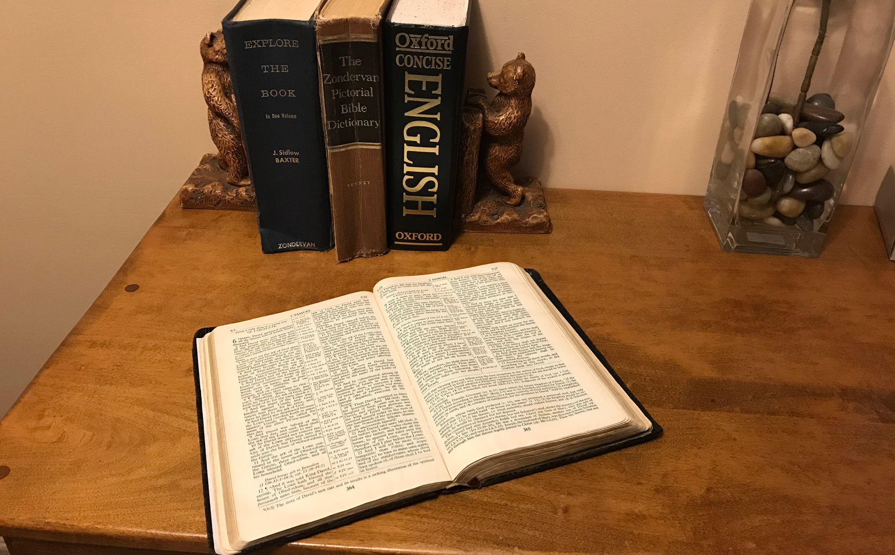
Notes:
86

Slide 8
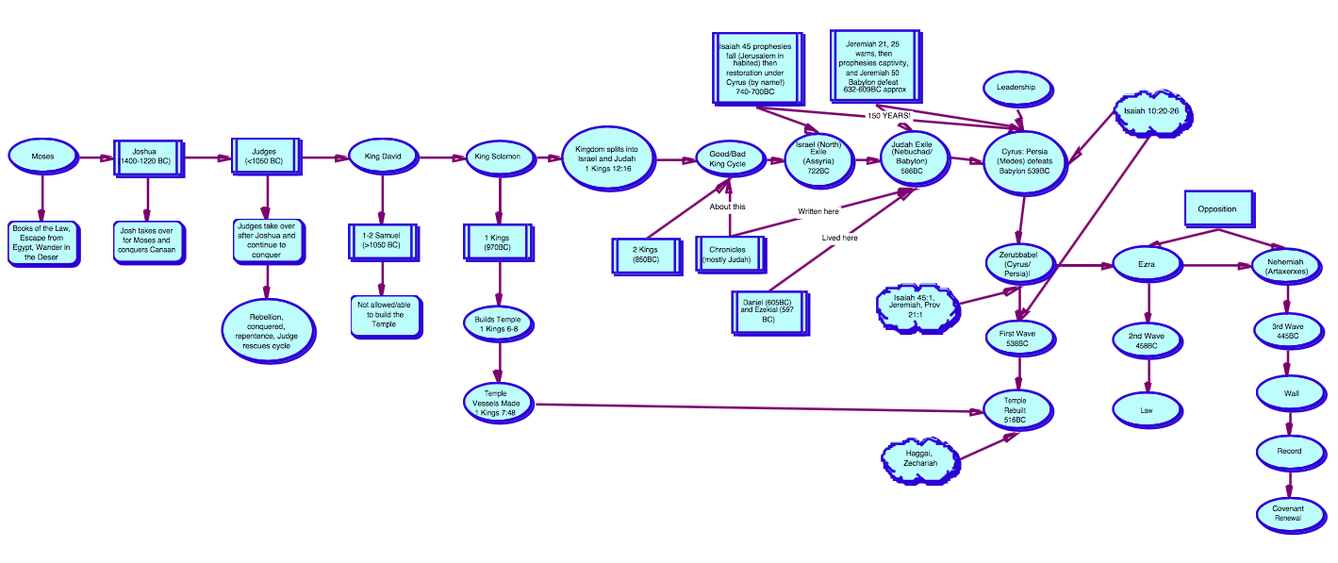

Slide 9
Haggai 1 (ESV)
² Then Zerubbabel the son of Shealtiel, and Joshua the son of Jehozadak, the high priest, with all the remnant of the people, obeyed the voice of the Lord their God, and the words of Haggai the prophet, as the Lord their God had sent him. And the people feared the Lord. ¹³ Then Haggai, the messenger of the Lord, spoke to the people with the Lord's message, “I am with you, declares the Lord.” ¹⁴ And the Lord stirred up the spirit of Zerubbabel the son of Shealtiel, governor of Judah, and the spirit of Joshua the son of Jehozadak, the high priest, and the spirit of all the remnant of the people. And they came and worked on the house of the Lord of hosts, their God, ¹⁵ on the twenty-fourth day of the month, in the sixth month, in the second year of Darius the king.

Slide 10
^{Ur verb}
^{To stir, to arouse, to awake.}

Slide 11
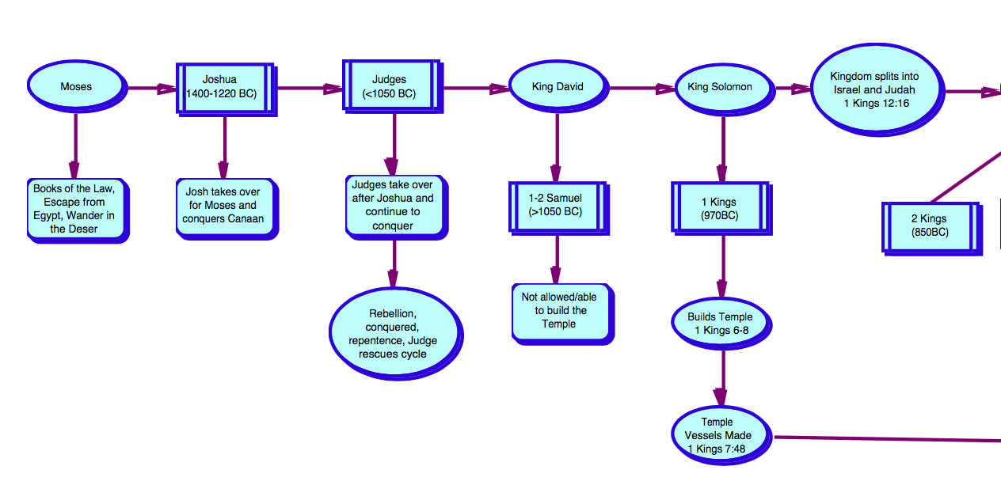

Slide 12
Old Testament
^{Genesis}
^{Exodus}
^{Leviticus}
^{Numbers}
^{Deuteronomy}
^{Joshua}
^{Judges}
^{Ruth}
^{1 Samuel}
^{2 Samuel}
^{1 Kings}
^{2 Kings}
^{1 Chronicles}
^{2 Chronicles}
^{Ezra}
^{Nehemiah}
^{Esther}
^{Job}
^{Psalms}
^{Proverbs}
^{Ecclesiastes}
^{Song of Solomon}
^{Isaiah}
^{Jeremiah}
^{Lamentations}
^{Ezekiel}
^{Daniel}
^{Hosea}
^{Joel}
^{Amos}
^{Obadiah}
^{Jonah}
^{Micah}
^{Nahum}
^{Habakkuk}
^{Zephaniah}
^{Haggai}
^{Zechariah}
^{Malachi}

Slide 13
Old Testament
^{Genesis}
^{Exodus}
^{Leviticus}
^{Numbers}
^{Deuteronomy}
^{Joshua}
^{Judges}
^{Ruth}
^{1 Samuel}
^{2 Samuel}
^{1 Kings}
^{2 Kings}
^{1 Chronicles}
^{2 Chronicles}
^{Ezra}
^{Nehemiah}
^{Esther}
^{Job}
^{Psalms}
^{Proverbs}
^{Ecclesiastes}
^{Song of Solomon}
^{Isaiah}
^{Jeremiah}
^{Lamentations}
^{Ezekiel}
^{Daniel}
^{Hosea}
^{Joel}
^{Amos}
^{Obadiah}
^{Jonah}
^{Micah}
^{Nahum}
^{Habakkuk}
^{Zephaniah}
^{Haggai}
^{Zechariah}
^{Malachi}

Slide 14
Kingdom Splits into Israel and Judah (1 Kings 12) 931 BC
Good King/Bad King Cycle
Israel (North Kingdom) Exiled to Assyria 722 BC
Judah (South Kingdom) Exiled to Babylon 566 BC
Approx. 400 years
2 Kings
1 Chronicles
2 Chronicles
Notes:
~400 years

Slide 15
Old Testament
^{Genesis}
^{Exodus}
^{Leviticus}
^{Numbers}
^{Deuteronomy}
^{Joshua}
^{Judges}
^{Ruth}
^{1 Samuel}
^{2 Samuel}
^{1 Kings}
^{2 Kings}
^{1 Chronicles}
^{2 Chronicles}
^{Ezra}
^{Nehemiah}
^{Esther}
^{Job}
^{Psalms}
^{Proverbs}
^{Ecclesiastes}
^{Song of Solomon}
^{Isaiah}
^{Jeremiah}
^{Lamentations}
^{Ezekiel}
^{Daniel}
^{Hosea}
^{Joel}
^{Amos}
^{Obadiah}
^{Jonah}
^{Micah}
^{Nahum}
^{Habakkuk}
^{Zephaniah}
^{Haggai}
^{Zechariah}
^{Malachi}

Slide 16
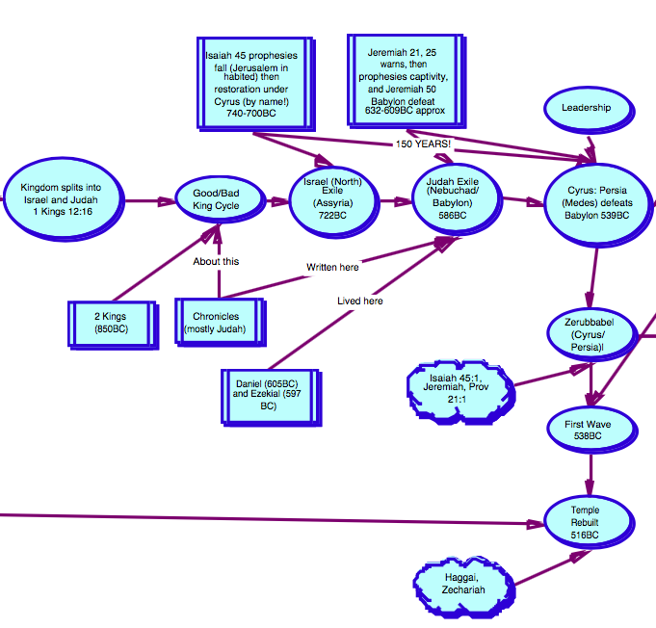
Kingdom Splits into Israel and Judah (1 Kings 12) 931 BC
Good King/Bad King Cycle
Israel (North Kingdom) Exiled to Assyria 722 BC
Judah (South Kingdom) Exiled to Babylon 566 BC
Hosea ~722 BC, Isaiah ~740 BC
Jeremiah
~632 BC
2 Kings
1 Chronicles
2 Chronicles
Notes:
~400 years

Slide 17
Old Testament
^{Genesis}
^{Exodus}
^{Leviticus}
^{Numbers}
^{Deuteronomy}
^{Joshua}
^{Judges}
^{Ruth}
^{1 Samuel}
^{2 Samuel}
^{1 Kings}
^{2 Kings}
^{1 Chronicles}
^{2 Chronicles}
^{Ezra}
^{Nehemiah}
^{Esther}
^{Job}
^{Psalms}
^{Proverbs}
^{Ecclesiastes}
^{Song of Solomon}
^{Isaiah}
^{Jeremiah}
^{Lamentations}
^{Ezekiel}
^{Daniel}
^{Hosea}
^{Joel}
^{Amos}
^{Obadiah}
^{Jonah}
^{Micah}
^{Nahum}
^{Habakkuk}
^{Zephaniah}
^{Haggai}
^{Zechariah}
^{Malachi}

Slide 18
539 BC
God’s People

Slide 19
Jeremiah 51:11 – approx. 632 BC
¹¹ “Sharpen the arrows! Take up the shields!
The Lord has stirred up the spirit of the kings of the Medes, because his purpose concerning Babylon is to destroy it, for that is the vengeance of the Lord, the vengeance for his temple.

Slide 20
Isaiah 45 (ESV) – before 700 BC
¹ Thus says the Lord to his anointed, to Cyrus, whose right hand I have grasped, to subdue nations before him and to loose the belts of kings, to open doors before him that gates may not be closed: ² “I will go before you and level the exalted places, I will break in pieces the doors of bronze and cut through the bars of iron,
³ I will give you the treasures of darkness and the hoards in secret places, that you may know that it is I, the Lord, the God of Israel, who call you by your name. ⁴ For the sake of my servant Jacob, and Israel my chosen, I call you by your name, I name you, though you do not know me. ⁵ I am the Lord, and there is no other, besides me there is no God; I equip you, though you do not know me, ⁶ that people may know, from the rising of the sun and from the west, that there is none besides me; I am the Lord, and there is no other.

Slide 21
2 Chronicles 36 (ESV) – after 539 BC
²² Now in the first year of Cyrus king of Persia, that the word of the Lord by the mouth of Jeremiah might be fulfilled, the Lord stirred up the spirit of Cyrus king of Persia, so that he made a proclamation throughout all his kingdom and also put it in writing: ²³ “Thus says Cyrus king of Persia, ‘The Lord, the God of heaven, has given me all the kingdoms of the earth, and he has charged me to build him a house at Jerusalem, which is in Judah. Whoever is among you of all his people, may the Lord his God be with him. Let him go up.’”
Notes:
150 years!

Slide 22
Haggai 1 (ESV) - approx. 538 BC
² Then Zerubbabel the son of Shealtiel, and Joshua the son of Jehozadak, the high priest, with all the remnant of the people, obeyed the voice of the Lord their God, and the words of Haggai the prophet, as the Lord their God had sent him. And the people feared the Lord. ¹³ Then Haggai, the messenger of the Lord, spoke to the people with the Lord's message, “I am with you, declares the Lord.” ¹⁴ And the Lord stirred up the spirit of Zerubbabel the son of Shealtiel, governor of Judah, and the spirit of Joshua the son of Jehozadak, the high priest, and the spirit of all the remnant of the people. And they came and worked on the house of the Lord of hosts, their God, ¹⁵ on the twenty-fourth day of the month, in the sixth month, in the second year of Darius the king.

Slide 23
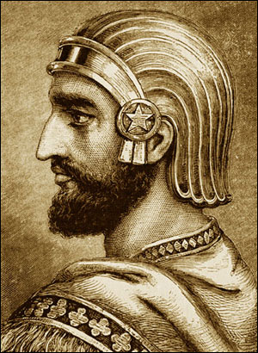
Zerubbael returns with First Wave to rebuild Temple 516 BC
Ezra returns with Second Wave to re-establish the Law 458 BC
Nehemiah returns with Third Wave to rebuild Wall 445 BC
Isaiah
Jeremiah,
Lamentations
539 BC
2 Chronicles
Ezra
Nehemiah
Haggai, Ezekiel, Daniel
Notes:
~400 years

Slide 24
Old Testament
^{Genesis}
^{Exodus}
^{Leviticus}
^{Numbers}
^{Deuteronomy}
^{Joshua}
^{Judges}
^{Ruth}
^{1 Samuel}
^{2 Samuel}
^{1 Kings}
^{2 Kings}
^{1 Chronicles}
^{2 Chronicles}
^{Ezra}
^{Nehemiah}
^{Esther}
^{Job}
^{Psalms}
^{Proverbs}
^{Ecclesiastes}
^{Song of Solomon}
^{Isaiah}
^{Jeremiah}
^{Lamentations}
^{Ezekiel}
^{Daniel}
^{Hosea}
^{Joel}
^{Amos}
^{Obadiah}
^{Jonah}
^{Micah}
^{Nahum}
^{Habakkuk}
^{Zephaniah}
^{Haggai}
^{Zechariah}
^{Malachi}

Slide 25
Ezra 1 (ESV)
¹ In the first year of Cyrus king of Persia, that the word of the Lord by the mouth of Jeremiah might be fulfilled, the Lord stirred up the spirit of Cyrus king of Persia, so that he made a proclamation throughout all his kingdom and also put it in writing:
² “Thus says Cyrus king of Persia: The Lord, the God of heaven, has given me all the kingdoms of the earth, and he has charged me to build him a house at Jerusalem, which is in Judah. ³ Whoever is among you of all his people, may his God be with him, and let him go up to Jerusalem, which is in Judah, and rebuild the house of the Lord, the God of Israel—he is the God who is in Jerusalem. ⁴ And let each survivor, in whatever place he sojourns, be assisted by the men of his place with silver and gold, with goods and with beasts, besides freewill offerings for the house of God that is in Jerusalem.”
⁵ Then rose up the heads of the fathers' houses of Judah and Benjamin, and the priests and the Levites, everyone whose spirit God had stirred to go up to rebuild the house of the Lord that is in Jerusalem.
Notes:
150 years!

Slide 27
2 Corinthians 1:3-7 (ESV)
³ Blessed be the God and Father of our Lord Jesus Christ, the Father of mercies and God of all comfort, ⁴ who comforts us in all our affliction, so that we may be able to comfort those who are in any affliction, with the comfort with which we ourselves are comforted by God. ⁵ For as we share abundantly in Christ's sufferings, so through Christ we share abundantly in comfort too.
⁶ If we are afflicted, it is for your comfort and salvation; and if we are comforted, it is for your comfort, which you experience when you patiently endure the same sufferings that we suffer. ⁷ Our hope for you is unshaken, for we know that as you share in our sufferings, you will also share in our comfort.
Notes:
150 years!

